Slide 1
eBaja
Octavio Duran – Budget Liason​
Brendon Jameson - CAD / Manufacturing Engineer​
Benjamin Plis - Test Engineer​
Abriana Romero - Project Manager​
Jared Walker - Logistics​

Slide 2

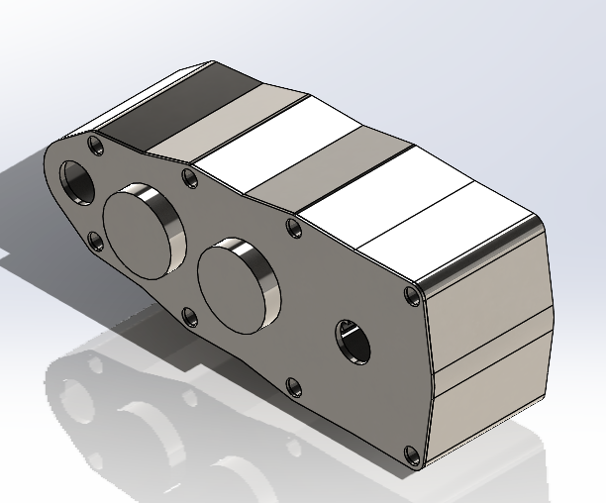
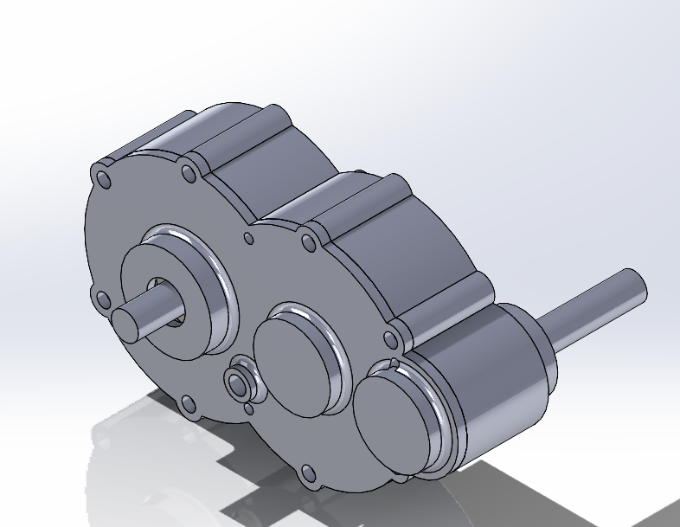
Design Efforts
Brendon Jameson 21F13​​
03/01/22

Slide 3
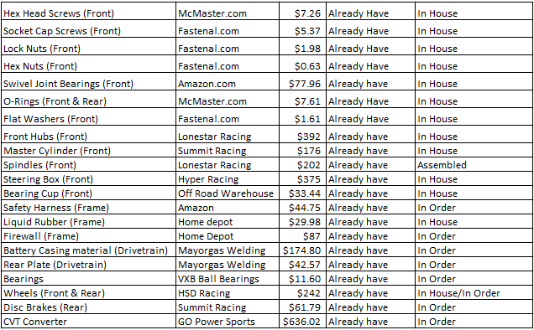

Purchasing Plan
BUDGET: $3,650
REMAINING BALANCE: $981.45
ALREADY PURCHASED
NEED TO PURCHASE
Octavio Duran 21F13​​
03/01/22

Slide 4
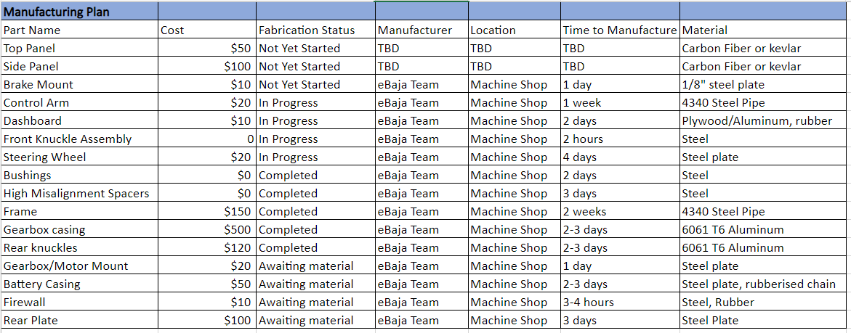
Manufacturing Plan
Abriana Romero 21F13​​
03/01/22

Slide 5
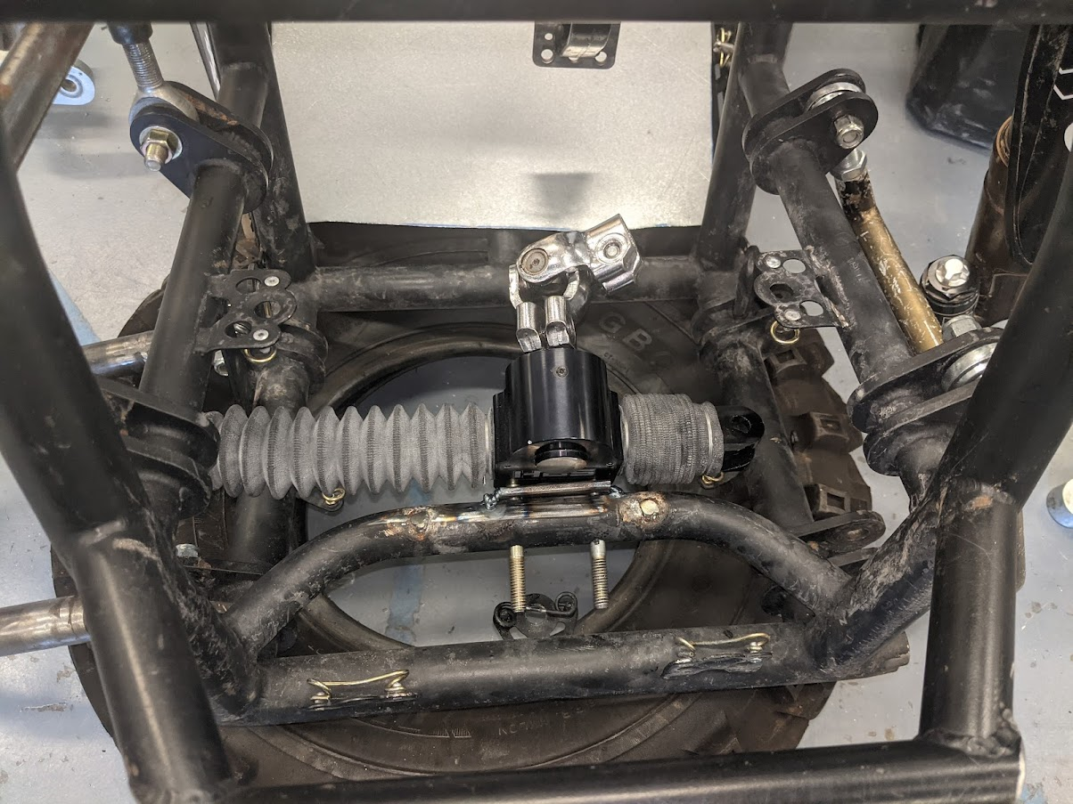
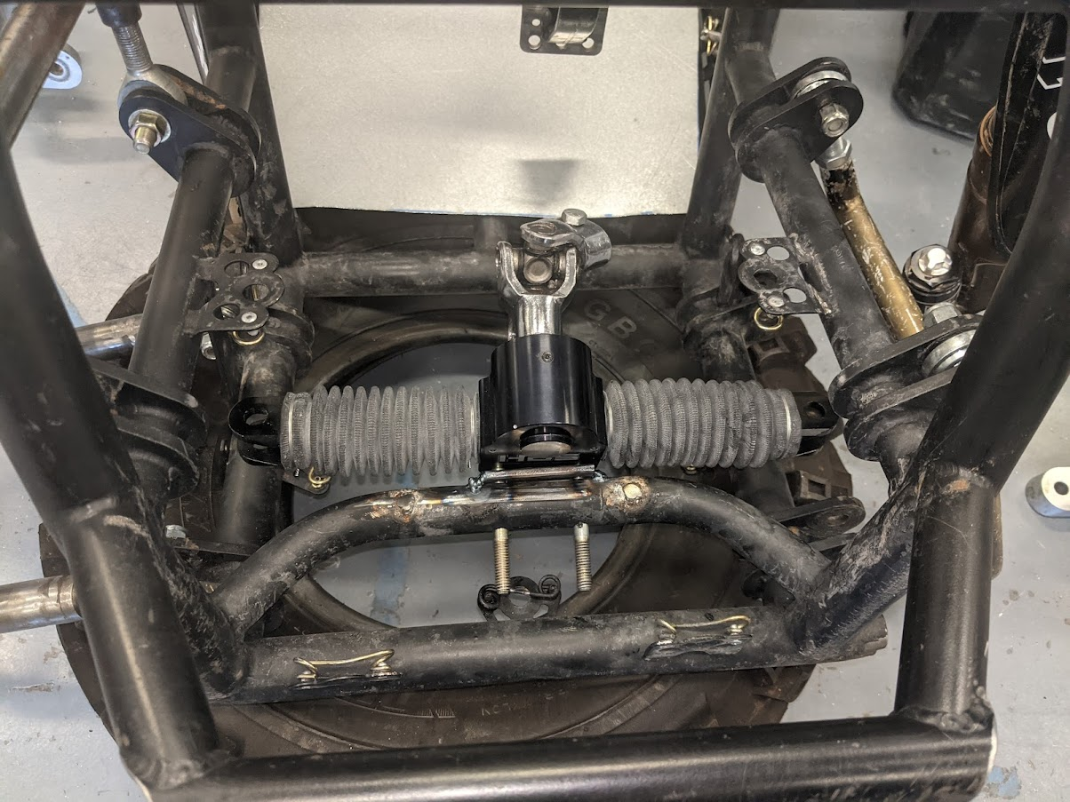
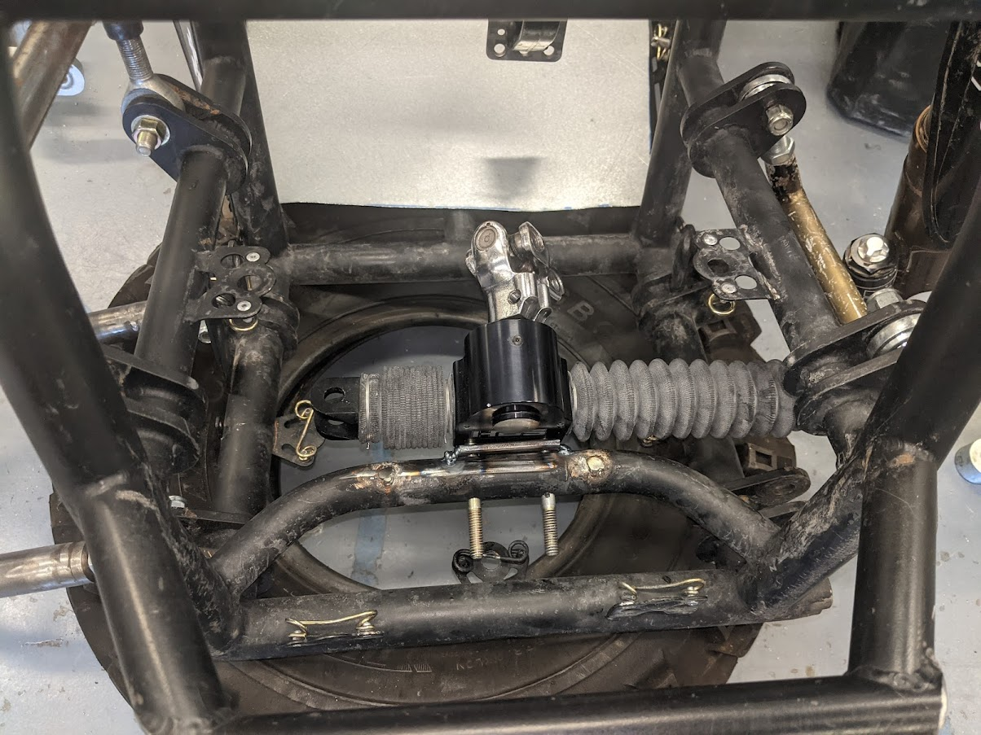
Demonstration
Benjamin Plis 21F13​
03/01/22

Slide 6
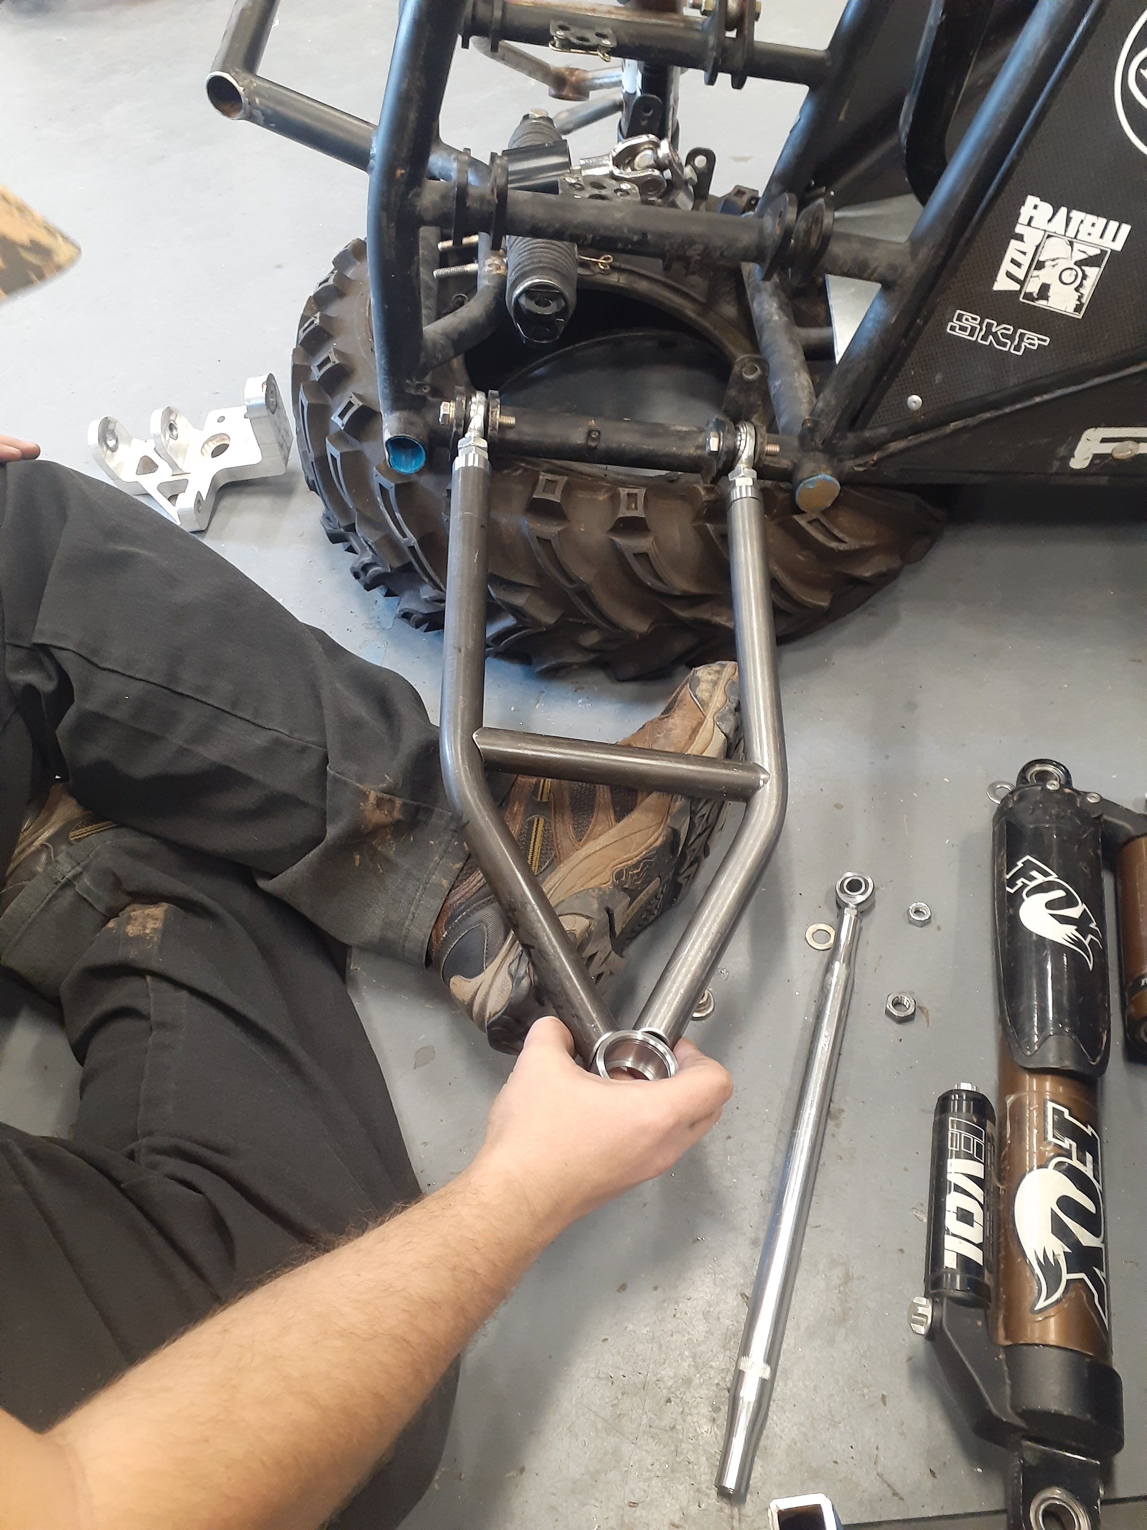
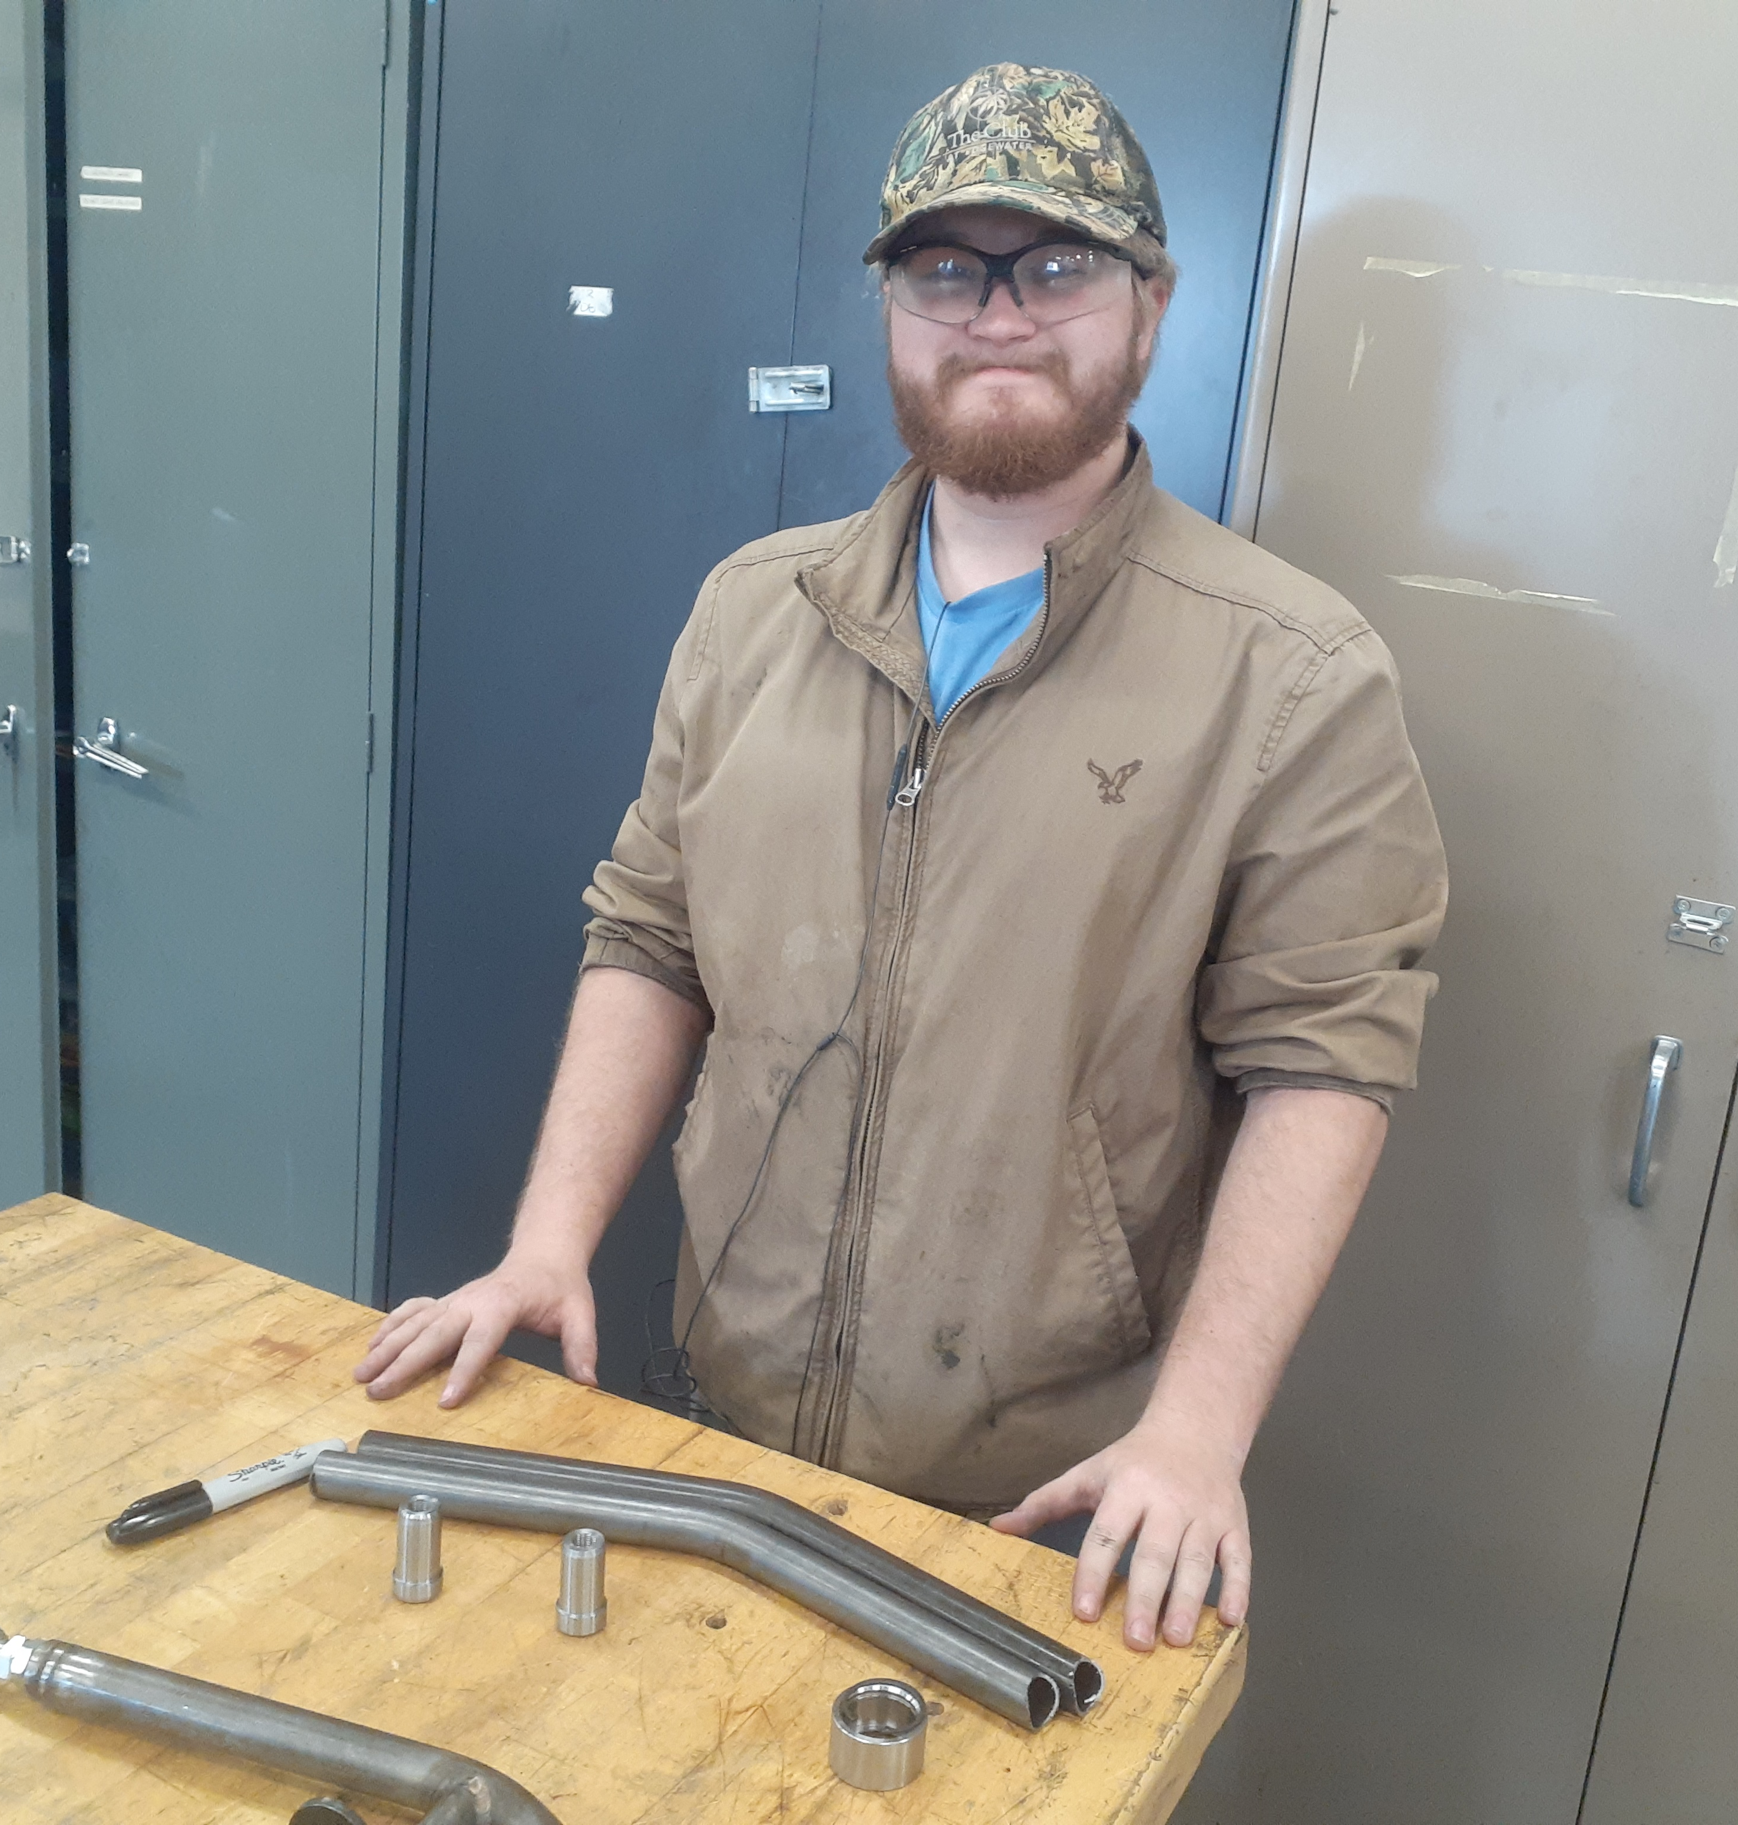
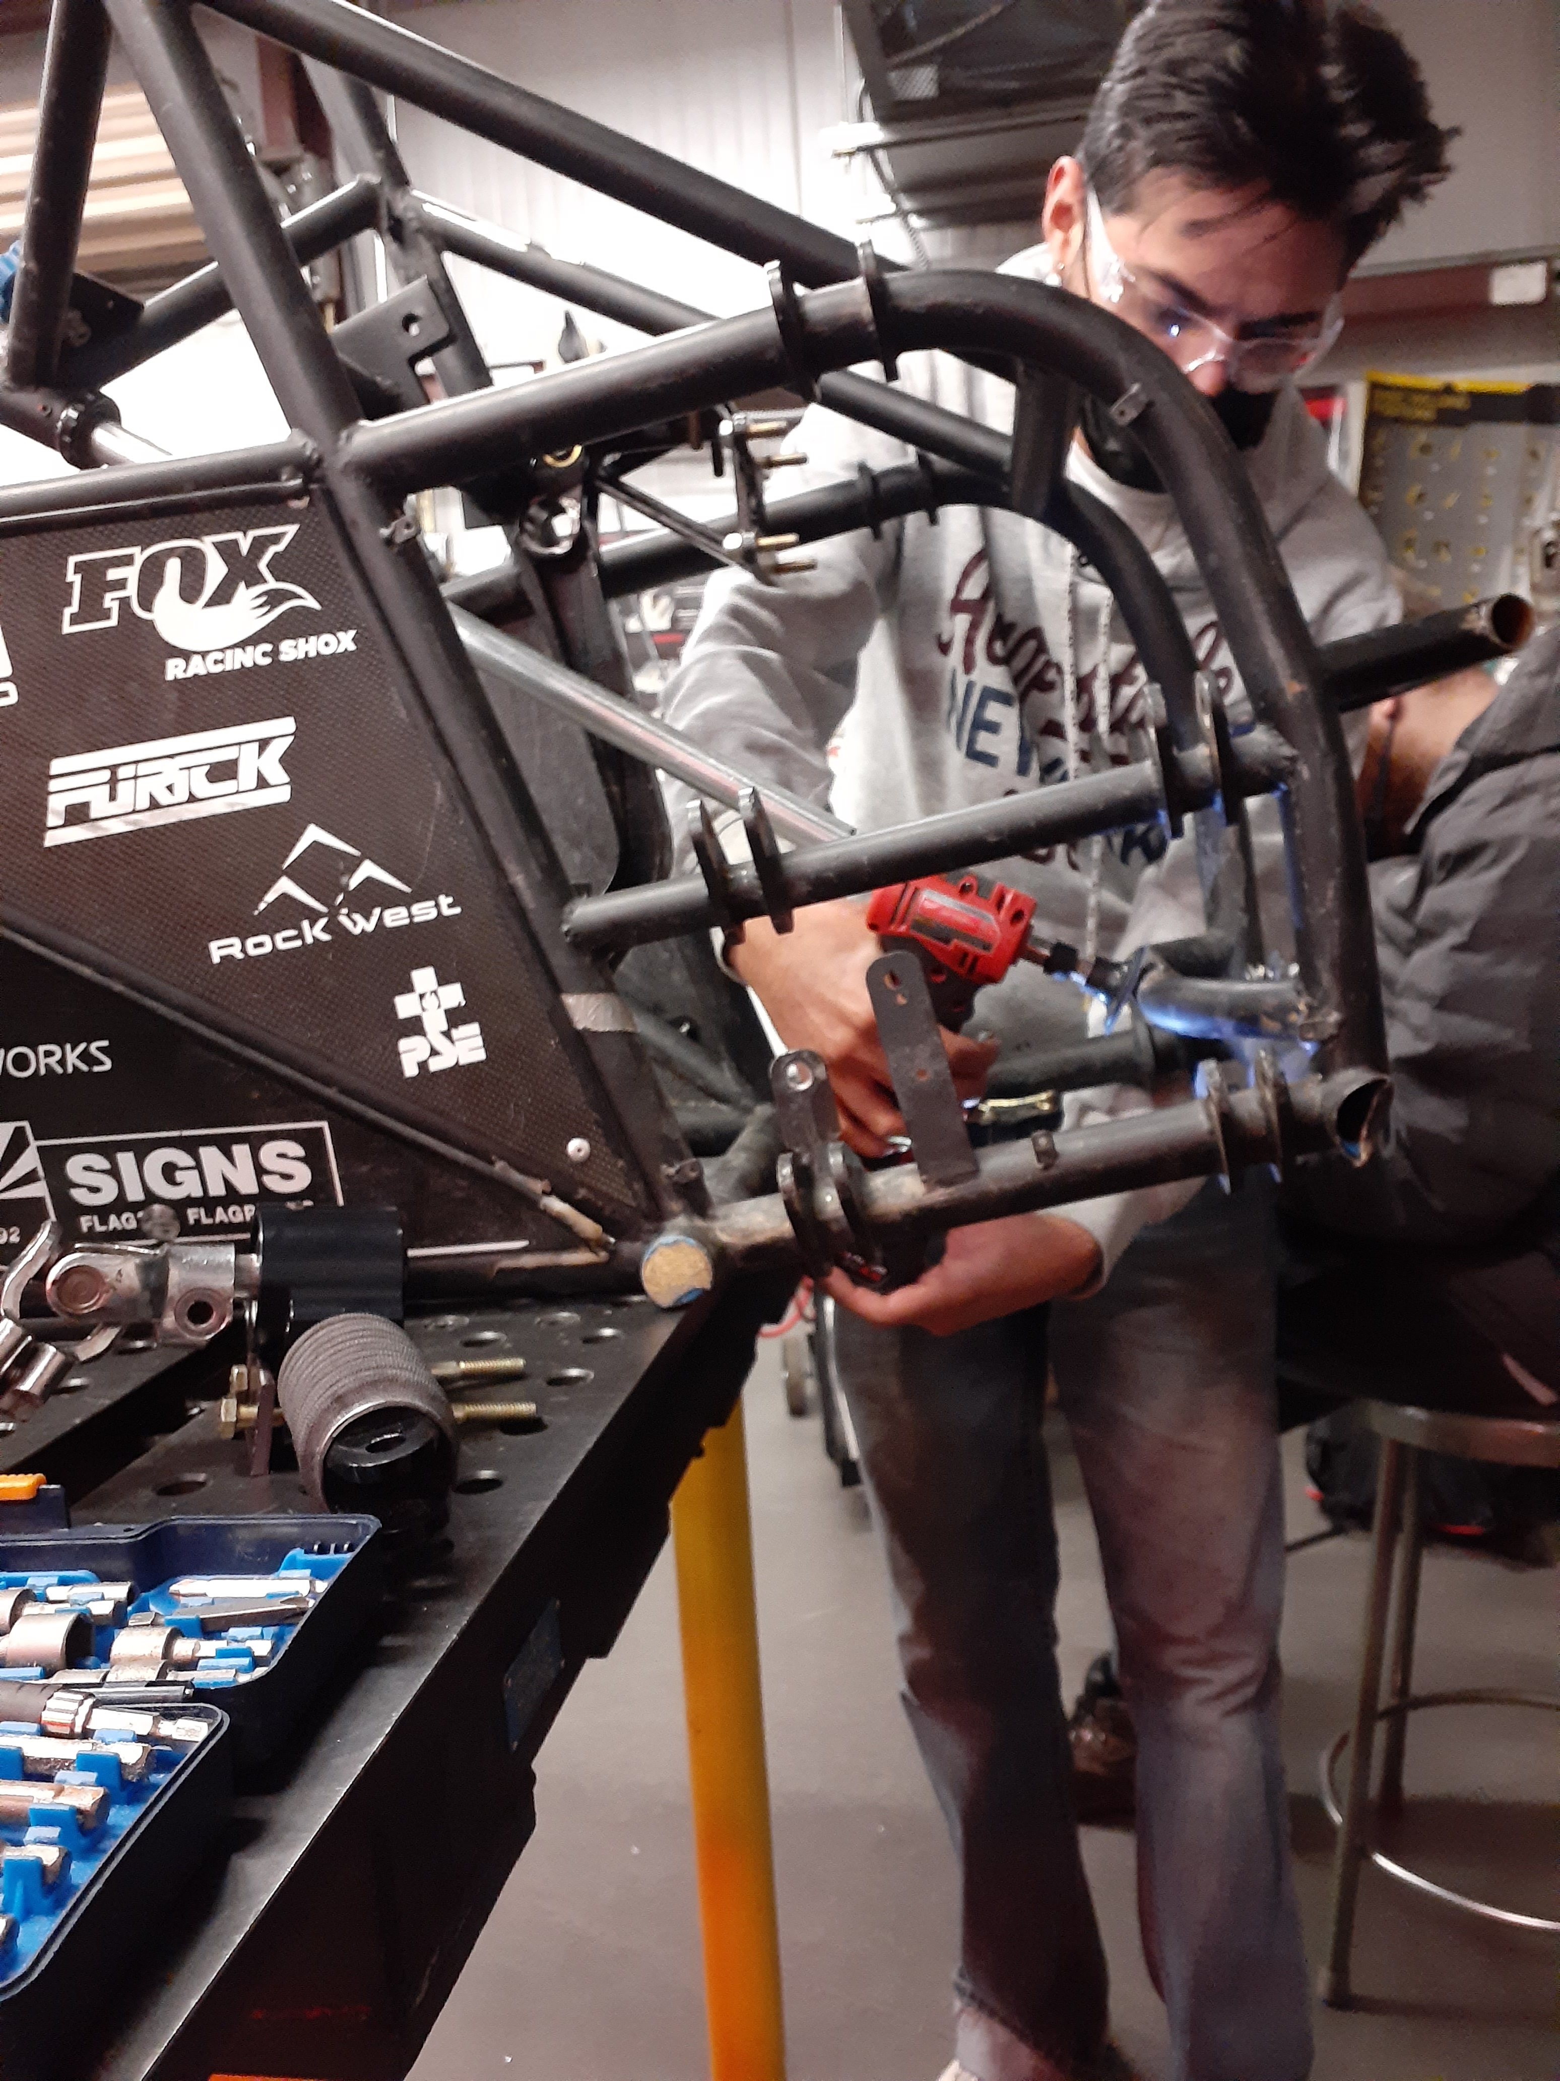
Demonstration
Jared Walker 21F13​​
03/01/22

Slide 7
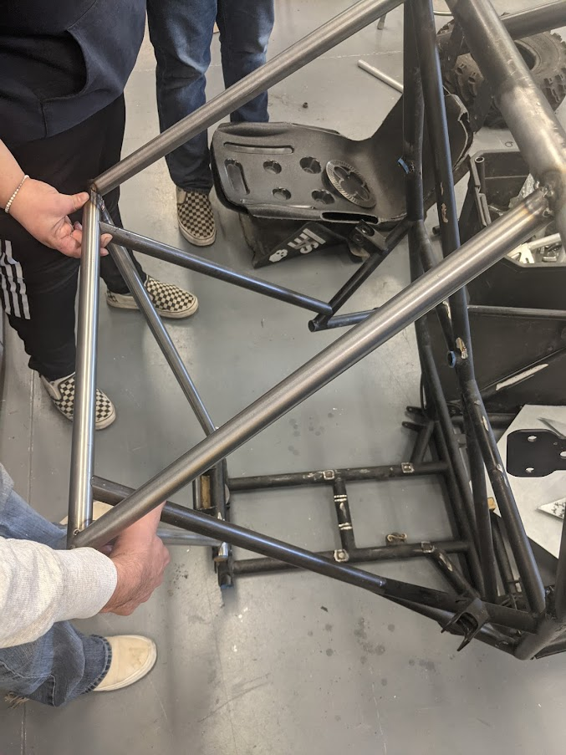
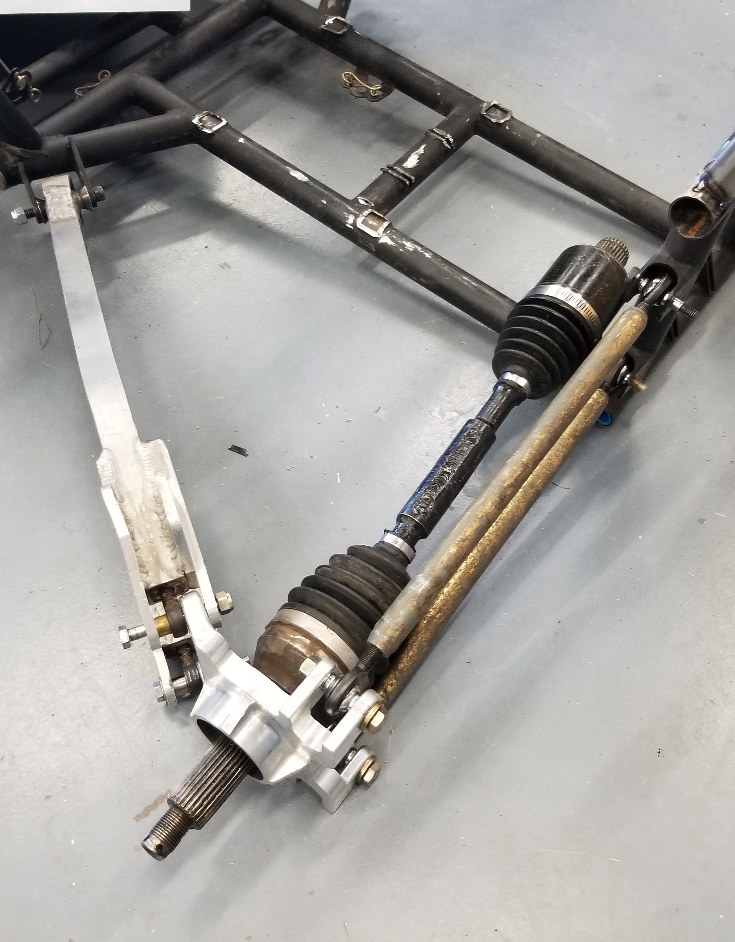
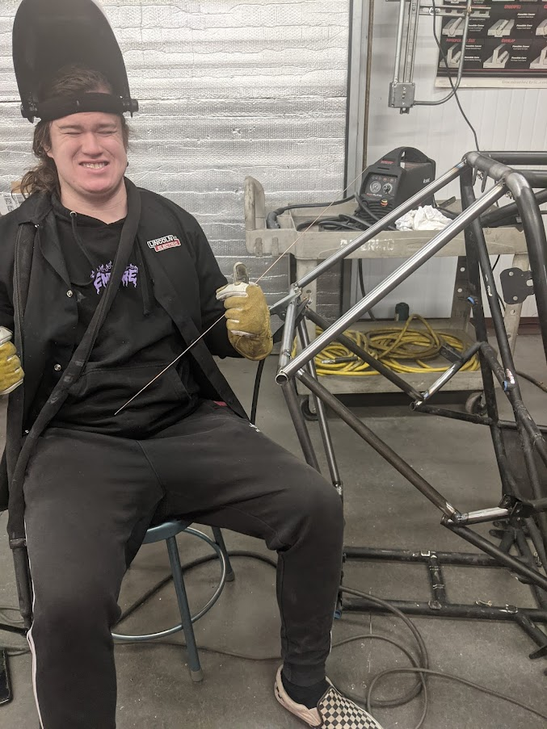
DEMONSTRATION
Abriana Romero 21F13
03/01/22

Slide 8
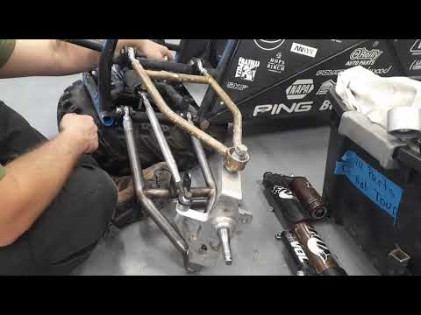
Demonstration - Steering
Benjamin Plis, Jared Walker 21F13​​
03/01/22

Slide 9
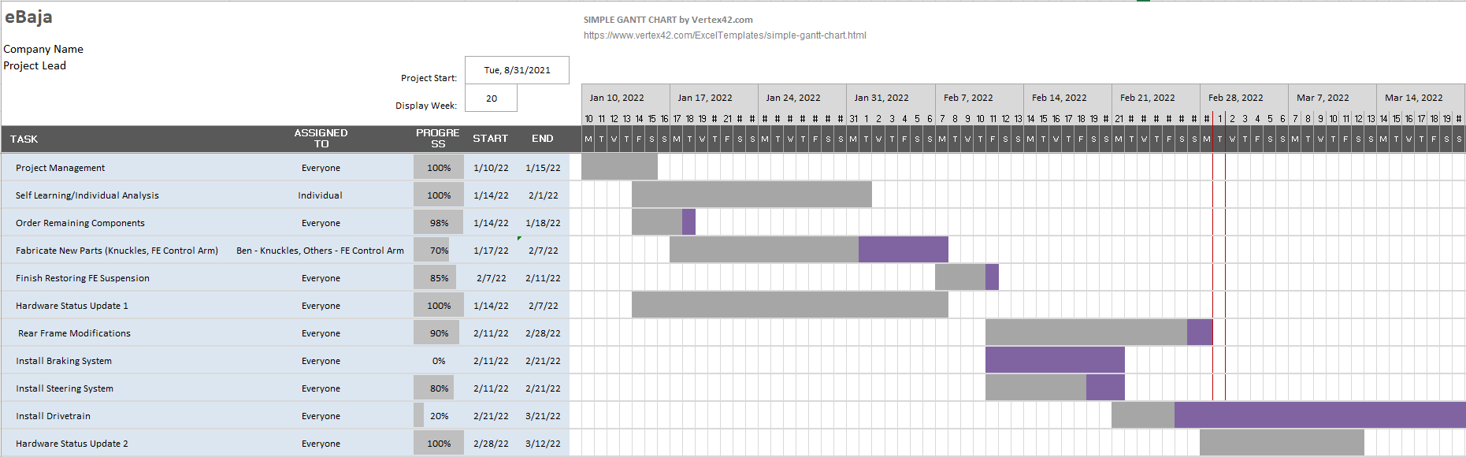
Gantt Chart
Octavio Duran 21F13​
03/01/22

Slide 10
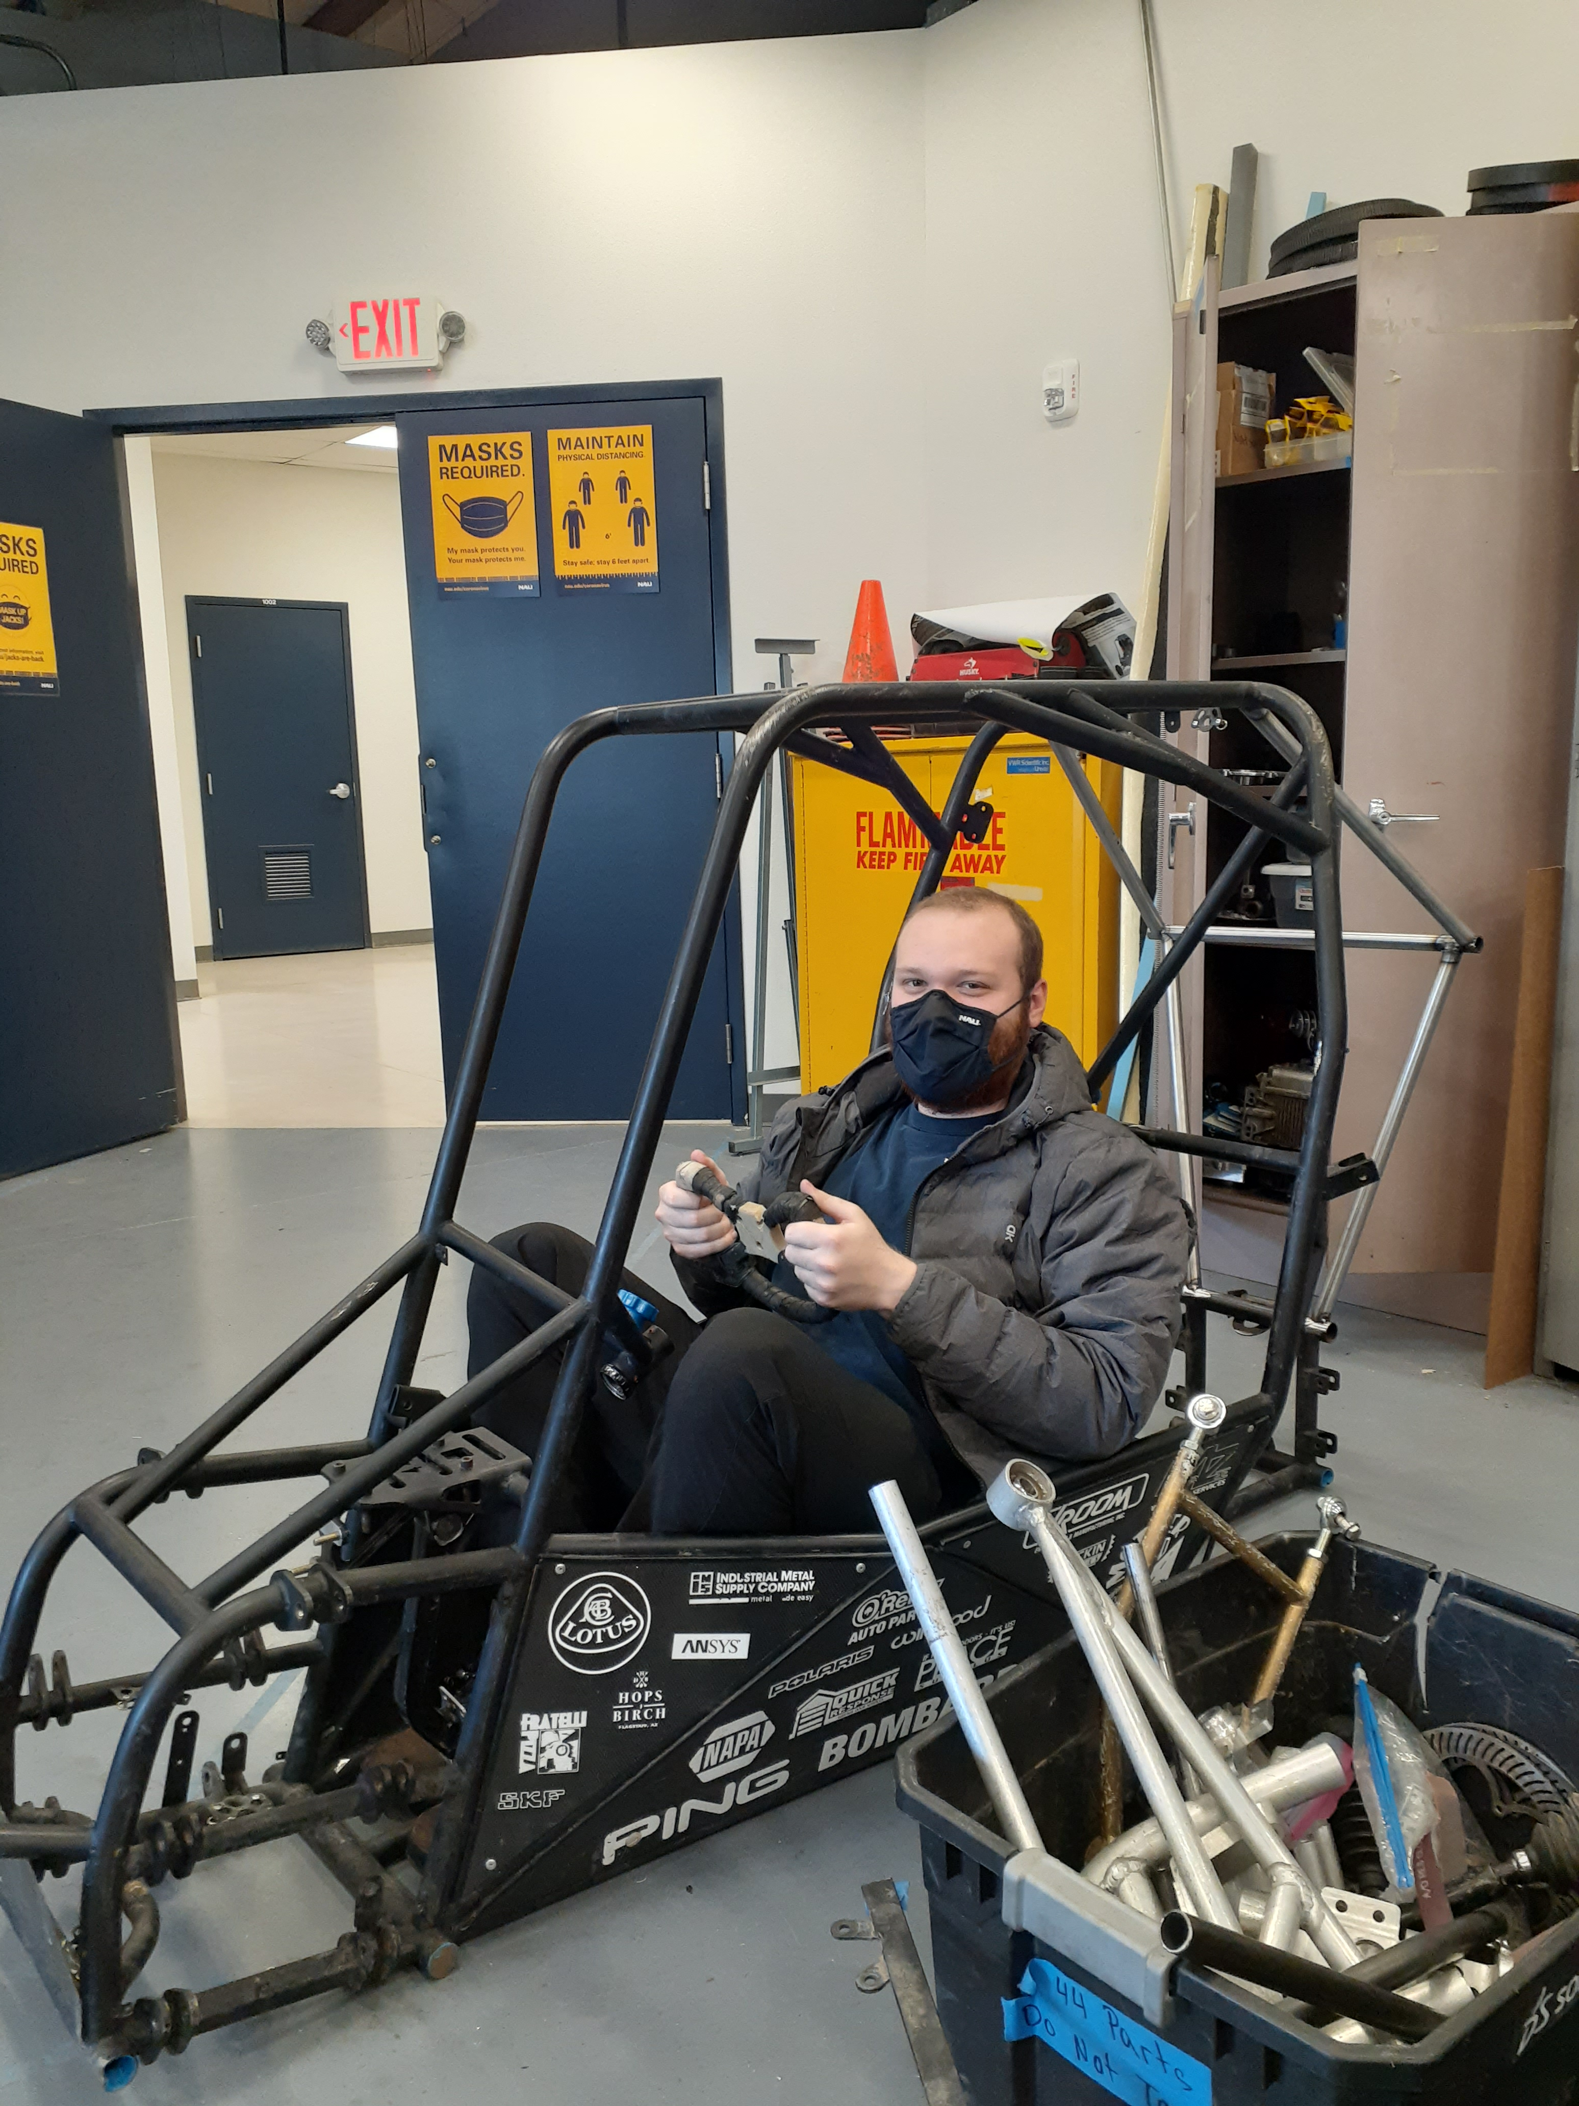
Questions?

